Slide 1

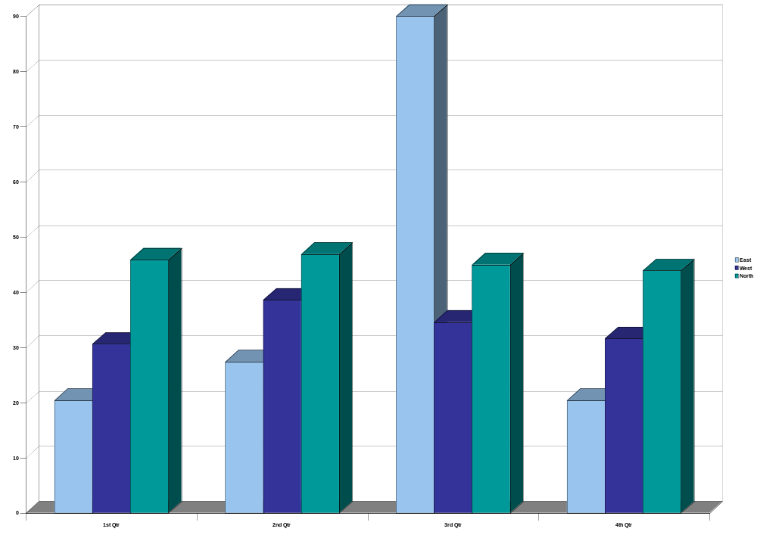

This is where you place your title
Names
Introduction
Method
UK research involving laboratory animals is conducted under the Animals (Scientific Procedures) Act 1986, widely recognized as the most comprehensive law of its kind in the world. Its aim is to balance the legitimate needs of research with the welfare of animals. The law has many provisions.
All the research, including a detailed explanation of its purpose, the likely effects on the animals and why the research cannot be done in other ways, must be approved in advance by the Home Office - the government department that oversees the Act.
UK research involving laboratory animals is conducted under the Animals (Scientific Procedures) Act 1986, widely recognized as the most comprehensive law of its kind in the world.
Results
Skin Penetration
Used to determine the extent to which cosmetic ingredients might penetrate the skin (which is important in determining whether they may enter the bloodstream and be carried to parts of the body causing toxic effects).
Skin Irritancy
Rabbits and guinea pigs are usually used for skin irritancy testing, with product being applied to shaved - and occasionally abraded - skin areas. Redness, ulcers, rashes or swelling.
Skin Sensitization
Guinea pigs are used in these tests which measure the likelihood of a substance causing allergy with repeated application. There are about 15 different tests, most of which require 20-40 animals.
Skin Penetration
Used to determine the extent to which cosmetic ingredients might penetrate the skin (which is important in determining whether they may enter the bloodstream and be carried to parts of the body causing toxic effects).
Skin Irritancy
Rabbits and guinea pigs are usually used for skin irritancy testing, with product being applied to shaved - and occasionally abraded - skin areas. Redness, ulcers, rashes or swelling.
Medical historians have shown that improved nutrition and sanitation standards and other behavioral and environmental factors—rather than knowledge gained from animal experiments—are responsible for the decreasing number of deaths from common infectious diseases since 1900 and that medicine has had little to do with increased life expectancy.
Many of the most important advances in the field of health care can be attributed to human studies, which have led to major medical breakthroughs, such as the development of anesthesia, the stethoscope, morphine, radium, penicillin, artificial respiration, x-rays, antiseptics, and CAT, MRI, and PET scans; the study of bacteriology and germ theory; the discovery of the link between cholesterol and heart disease and the link between smoking and cancer; and the isolation of the virus that causes AIDS.
Conclusion
The breeding and supply of animals for use in scientific procedures is regulated in the UK by the Animals (Scientific Procedures) Act 1986.
Proposals to use animals in scientific projects are individually scrutinized. Project licenses are only granted when: there is no validated alternative to animal tests the generation of new test data is justified the protocols proposed cannot be further refined the protocols will be likely to produce data which will meet the specified objective.
All laboratories granted a license must adhere to a strict code of practice which stipulates minimum standards for: animal housing and environment animal care and health minimized breeding of surplus animals humane killing.
Proposals to use animals in scientific projects are individually scrutinized. Project licenses are only granted when: there is no validated alternative to animal tests the generation of new test data is justified the protocols proposed cannot be further refined the protocols will be likely to produce data which will meet the specified objective.
All laboratories granted a license must adhere to a strict code of practice which stipulates minimum standards for: animal housing and environment animal care and health minimized breeding of surplus animals humane killing.
Photo Name Here
Chart Name Here
Notes:
Template ID: h108_4x6

